Slide 1
Social Security Financial & Estate Planning
Lee Gibson MBA, RICP
Office 281-444-8732, Cell:713-557-3476
www.HoustonStrategic.com
14550 Torrey Chase Blvd, #360 Houston, TX 77014
Notes:
Greeting – Rapport

Slide 2
Disclaimer
This information is not legal or tax advise. Always consult with a legal and or tax professional. This information is intended for educational purposes only and is not to be construed an investment or planning advice.
All information is based on sources deemed reliable, but no warranty or guarantee is made as to its accuracy or completeness. Past performance is no guarantee of future results. All investing involves risk, including the potential loss of principal, and there can be no guarantee that any investing strategy will be successful.
Securities offered through Concourse Financial Group Securities, Inc. (CFGS), Member FINRA/SIPC. Advisory services offered through Concourse Financial Group Advisors, a DBA for CFGS, a Registered Investment Advisor. Strategic Financial Advisors is independent of CFGS

Slide 3
Discussion Sequence
Social Security
How to estimate my benefits and finding the best strategy
Claiming income benefits early, at FRA and waiting until age 70
Financial Planning for younger families
What, How & Why
Investment Management
Financial Planning for someone close to Retirement
What to consider, How & Why
How to manage them
Estate Planning

Slide 4
Let’s look at Social Security
Log in to MySocialSecurity website from SSA.gov
Review the earning history to determine if the projections are applicable
What is the significance of 30 years and 35 years of substantial earnings?
What if you retire early or wait until age 70?
Taking SS early –meeting living expenses / shortened life expectancy
Delaying to 70 – COLA, higher monthly when claiming and late life greater benefit
Claiming decisions based on self or family
Medicare eligibility – for self & spouse 40 quarters (either person)
Disability and Death benefits from Social Security
Benefits to a divorcee
Notes:
What makes you and your situation as it relates to health and healthcare unique.
At anytime please stop me and ask whatever comes to mind.

Slide 5
Benefits to using Social Security software
10,000+ claiming strategies
Compare different strategies
Run What if scenarios
Continue to earn and replace lower earning years
Consider taxes, the % of SS that is taxable and COLA
Consider the impact on SS of an untimely death, divorce or disability
Claim, continue working and calculate the impact of the earnings test
Claim, suspend and claim again (start, stop, start)
Identify the optimal point for each spouse to claim in concert with the other

Slide 6
Financial Planning for younger families
Value of compounding – start saving early -10,000 becomes 20 becomes 40
Understand human behavior and how markets misbehave
Passive verses Active Management - Is one better?
Assessing various financial products and their ability to achieve the desired outcome
Your ability to generate income is your greatest asset
Know where your money is going, your values and your objectives
Consider tax management in your wealth building strategy
Understand the trade-offs for every decision
How much insurance - health, life and casualty
Strike the perfect balance of savings for college, retirement and legacy

Slide 7
Compounding creates wealth over long periods of time

Slide 8
Challenges and common mistakes
One spouse losing healthcare coverage due to the other losing their group coverage from going on to Medicare
Taking too much risk or adjusting too late to get back on track
Having too much qualified savings and not enough nonqualified funds
Betting too heavily on a single outcome
Allowing emotion to preside over intellect and probability

Slide 9
Planning for Retirement
Goals:
Lifestyle
Legacy
Life Purpose
Bucket List

Slide 10
Planning for Retirement
Investment Selection and Management
Sequence of Returns Risk & Liquidity Risk
Longevity, Loss of Spouse or Divorce
Inflation & Interest rate risk
Spending Shock or Overspending
Job Loss & Reemployment
Health risk
Healthcare Expense prior to and subsequent to Medicare eligibility
Dependent Family – children and parents
Non-Market Investment and Casualty Losses

Slide 11
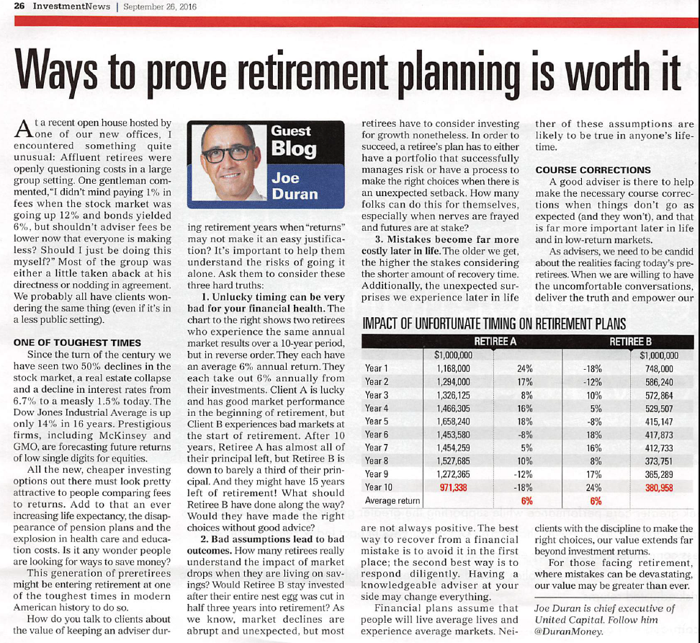
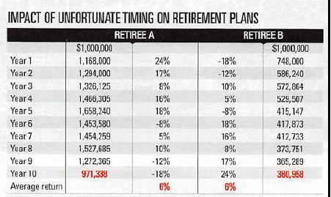
Sequence of Return Risk

Slide 12
Investment Management
Diversification: asset classes, sectors, weighting
The economic cycle
Product mix to achieve objectives
Ordinary income and capital gains tax management
Historical results combined with strategy, objectives and constraints Evaluations for markets, managers and indexes
Dynamic tactical management verses strategic
Transparency & value with regard to fees and expenses

Slide 13
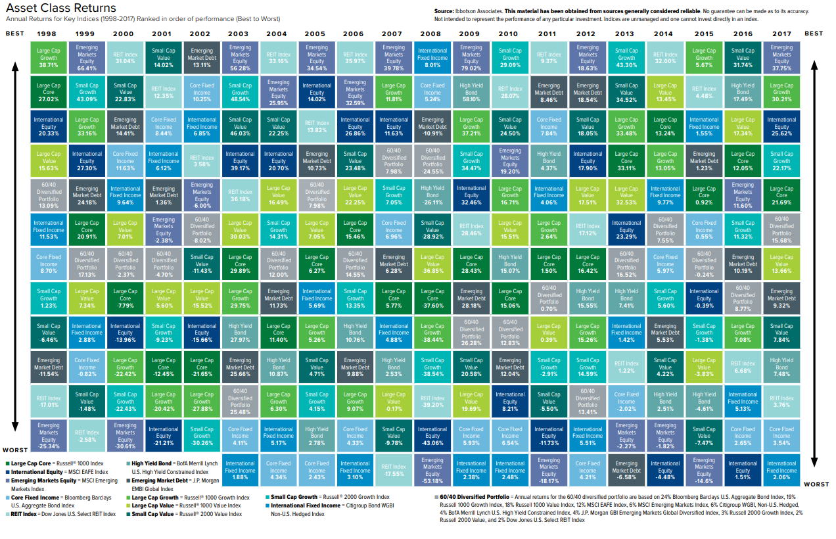

Slide 14
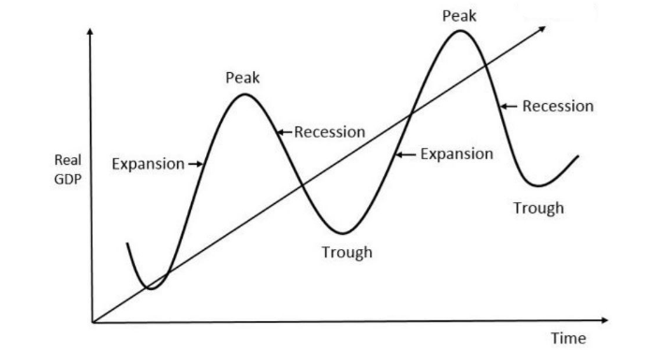
Business Cycle

Slide 15
Products to be aware of
Qualified retirement plans
Non-qualified retail accounts
Real Estate: Investment Property, Homestead, REITS
Private Equity
Business Interests: Schedule C, 1099, LLC, Limited Partnership
Life Insurance Term life, Universal life, Annuities
Trusts
529 Plans
Donor Advised Fund

Slide 16
Estate tools
A Will verses Texas State Law
Probate (processing time, asset exposure to the public, expenses)
Life Insurance
Transfer on Death Deed for Texas Real Estate
Annuity – period certain
Beneficiary designation on qualified accounts
Joint with rights of survivor
Payable on death designation
Transfer on death designation
Durable Power of Attorney
Advance Directives

Slide 17
The value of an advisor
Guides perspective on decision making
Infuses pertinent new information into the analysis
Provides access to specialty tools and resources
Has the training and experience for solving the challenge you’re facing
Achieves a more favorable risk reward ratio
Identifies opportunities to eliminate cost and waste
Structures and balances plans to your preferences for:
certainty, flexibility and probability
independence, collaboration and delegation
Brings a human understanding to a complex situation
Enhances the ease, speed and certainty for your definition of success

Slide 18
The you for your time and attention
If you question wasn’t answered, please submit it to:
LGibson@HoustonStrategic.com
Cell Phone: 713-557-3476
For Text Messages please use: 936-281-2202
Securities offered through Concourse Financial Group Securities, Inc. (CFGS), Member FINRA/SIPC. Advisory services offered through Concourse Financial Group Advisors, a DBA for CFGS, a Registered Investment Advisor. Strategic Financial Advisors is independent of CFGS

